Slide 1
Correlation Chapter 2
CS 637, St. Elizabeth's University, Fall 2021

Slide 2
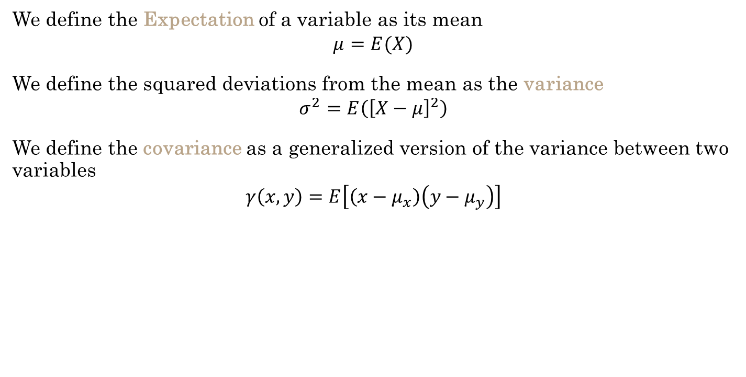
Correlation
We define the Expectation of a variable as its mean
$$μ=E(X)$$
We define the squared deviations from the mean as the variance
$$σ^{2}=E\left({\left[X−μ\right]}^{2}\right)$$
We define the covariance as a generalized version of the variance between two variables
$$γ\left(x,y\right)=E\left[\left(x−μ_{x}\right)\left(y−μ_{y}\right)\right]$$
The covariance is a measure of linear association
between two variables (x, y)

Slide 3
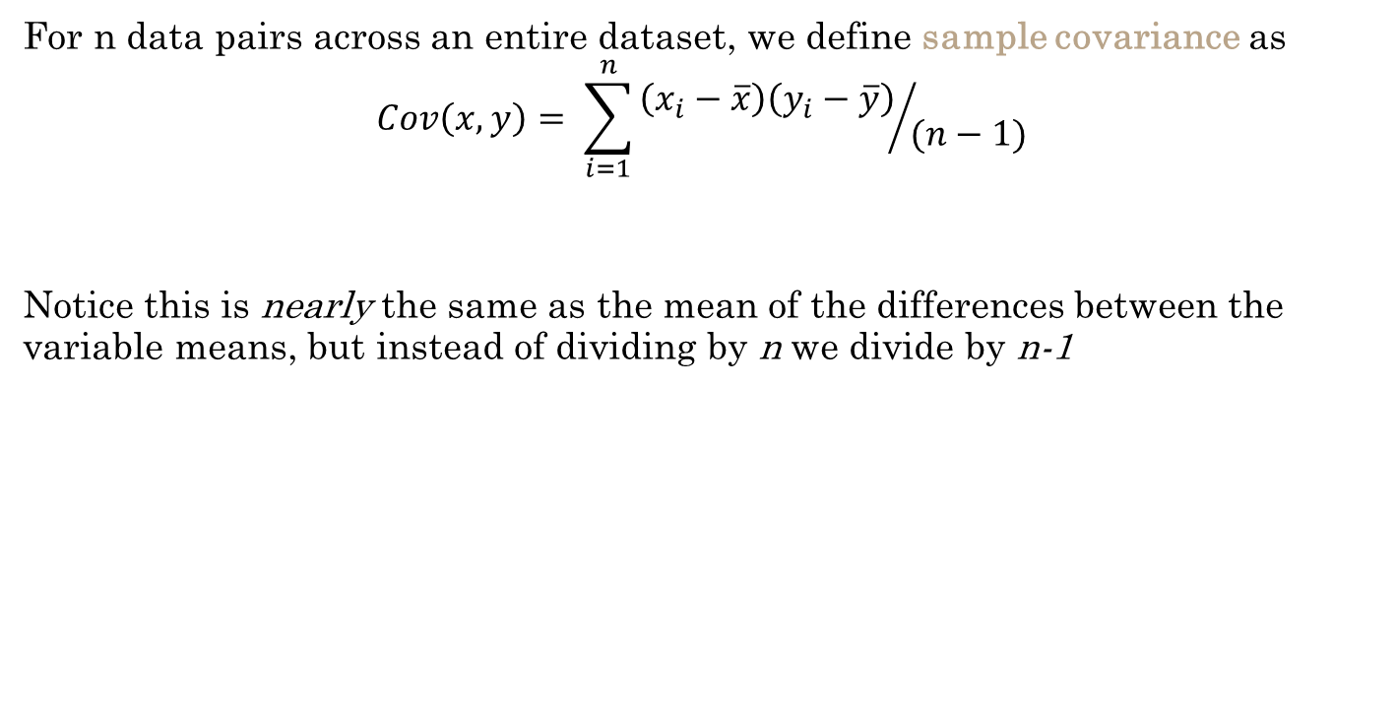
Correlation Covariance
For n data pairs across an entire dataset, we define sample covariance as
$$Cov\left(x,y\right)= \sum_{i=1}^{n}{{\left(x_{i}−\overline{x}\right)\left(y_{i}−\overline{y}\right)}/{(n−1)}}$$
Notice this is nearly the same as the mean of the differences between the variable means, but instead of dividing by n we divide by n-1

Slide 4
Lecture 2.RMarkdown
Correlation

Slide 5
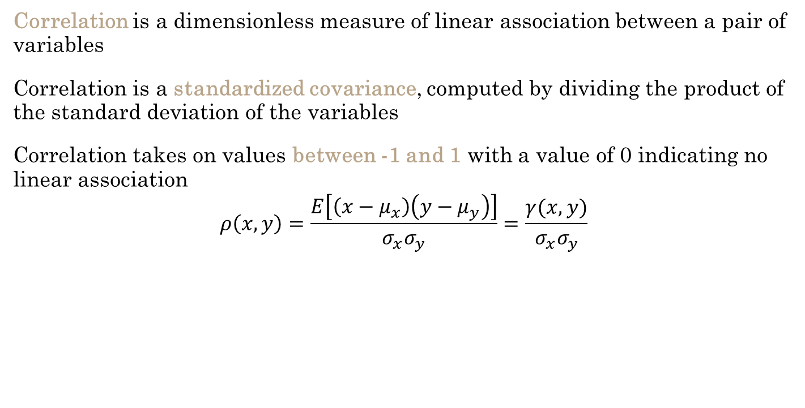
Correlation
Correlation is a dimensionless measure of linear association between a pair of variables
Correlation is a standardized covariance, computed by dividing the product of the standard deviation of the variables
Correlation takes on values between -1 and 1 with a value of 0 indicating no linear association
$$ρ\left(x,y\right)=\frac{E\left[\left(x−μ_{x}\right)\left(y−μ_{y}\right)\right]}{σ_{x}σ_{y}}=\frac{γ(x,y)}{σ_{x}σ_{y}}$$

Slide 6
Lecture 2.RMarkdown
Correlation

Slide 7

Correlation Ergodic Series
A time series model that is stationary in the mean is ergodic in the mean if the time average for a single time series tends to the ensemble mean as the length of the time series increases
$$\lim_{n→∞}{\frac{\sum{x_{t}}}{n}}=μ$$

Slide 8
Correlation Second Order Properties
Second order properties of time series data include the mean, variance, and autocorrelation
A time-series model is second-order stationary if the correlation between variables depends only on the number of time steps separating them
The number of time steps between the variables is known as the lag
A correlation of a variable with itself at different times is known as autocorrelation or serial correlation

Slide 9

Correlation Autocovariance
The autocovariance function is defined as
$$γ_{k}=E\left[\left(x_{t}−μ\right)\left(x_{t+k}−μ\right)\right]$$
The autocorrelation function is defined as
$$ρ_{k}=\frac{γ_{k}}{σ^{2}}$$

Slide 10
Lecture 2.RMarkdown
Correlation

Slide 11
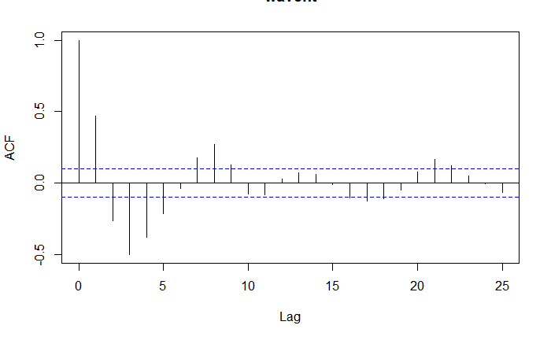
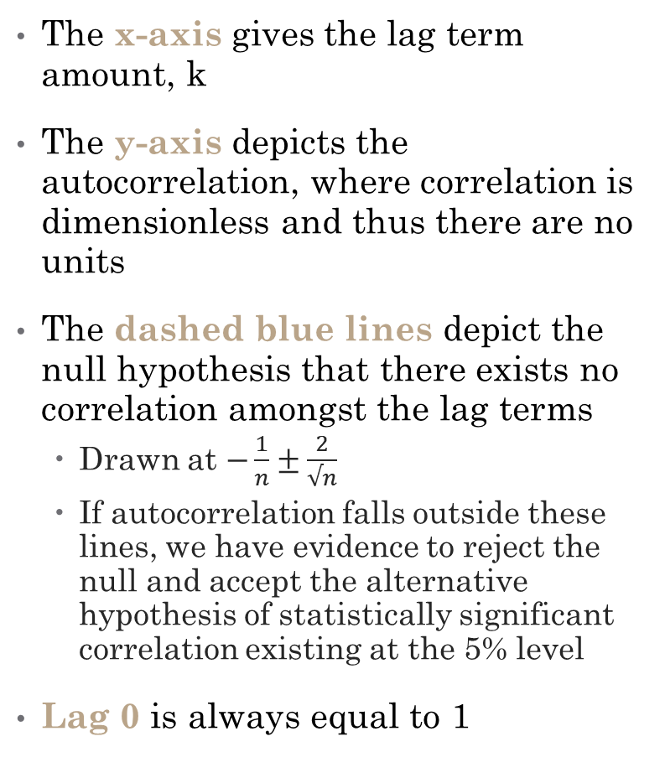
Correlation Autocorrelation
The x-axis gives the lag term amount, k
The y-axis depicts the autocorrelation, where correlation is dimensionless and thus there are no units
The dashed blue lines depict the null hypothesis that there exists no correlation amongst the lag terms
Drawn at $−\frac{1}{n}±\frac{2}{√n}$
If autocorrelation falls outside these lines, we have evidence to reject the null and accept the alternative hypothesis of statistically significant correlation existing at the 5% level
Lag 0 is always equal to 1

Slide 12
Lecture 2.RMarkdown
Correlation

Slide 13

Correlation Covariance of Sums of Random Variables
The covariance of two sums of variables is the sum of all possible covariance pairs of the variables
$$Cov\left(\sum_{i=1}^{n}{x_{i}},\sum_{i=1}^{n}{y_{i}}\right)=\sum_{i=1}^{n}{\sum_{j=1}^{m}{Cov\left(x_{i},{xy}_{j}\right)}}$$

